Slide 1
18CSS202J COMPUTER COMMUNICATIONS PROJECT CAMPUS NETWORK DESIGN

Slide 2
Abstract
This project is to design a suitable network system for universities in developing countries. The aim was to design a network with high security and low cost. This project will help to enhanced education of developing countries. The advantages of networking can be seen clearly in terms of efficiency, security, manageability and cost as it allows collaboration between users in a wide area. To improve college campus network design, the technology used was creating LAN, WLAN and using cheap device to reduce cost of the network. But the network can also become better using routing protocols and other protocol. So, we are going to use such protocols using less number of devices and will also maintain the cost of the network less. To design such network, we are going to use software Cisco-Packet Tracer

Slide 3
Team MEMBER
SHIVANSH SINGH -RA2011003010950

Slide 4
CONTENTS
INTRODUCTION
LITERATURE SURVEY
NETWORK REQUIREMENTS
NETWORK DESIGN AND ARCHITECTURE
CONCLUSION
REFERENCES

Slide 5
LITERATURE SURVEY
WIRELESS NETWORK
Admin telecommunications networks are normally introduced and administered using radio communication. This exercise takes place at the physical level of OSI (layer)
The first technical wireless network was established under the brand ALOHAnet at the University of Hawaii in 1969 and became operational in June 1971. The first commercial wireless network was the WaveLAN family of products developed by NCR in 1986.

Slide 6
The concept of an Interface computer was first proposed by Donald Davies for the NPL network in 1966. The same idea was conceived by Wesley Clark the following year for use in the ARPANET. Named Interface Message Processors (IMPs), these computers had fundamentally the same functionality as a router does today. The idea for a router (called gateways at the time) initially came about through an international group of computer networking researchers called the International Networking Working Group (INWG). Set up in 1972 as an informal group to consider the technical issues involved in connecting different networks, it became a subcommittee of the International Federation for Information Processing later that year. These gateway devices were different from most previous packet switching schemes in two ways. First, they connected dissimilar kinds of networks, such as serial lines and local area networks. Second, they were connectionless devices, which had no role in assuring that traffic was delivered reliably, leaving that entirely to the hosts. This particular idea, the end-to-end principle, had been previously pioneered in the CYCLADES network.

Slide 7
SWITCH
A network switch is a multiport network bridge that uses MAC addresses to forward data at the data link layer (layer 2) of the OSI model. Some switches can also forward data at the network layer (layer 3) by additionally incorporating routing functionality. Such switches are commonly known as layer-3 switches or multilayer switches.
Switches for Ethernet are the most common form of network switch. The first Ethernet switch was introduced by Kalpana in 1990. Switches also exist for other types of networks including Fibre Channel, Asynchronous Transfer Mode,
and InfiniBand.
ADSL
ADSL was specifically designed to exploit the one-way nature of most multimedia communication in which large amounts of information flow toward the user and only a small amount of interactive control information is returned. Several experiments with ADSL to real users began in 1996. In 1998, wide-scale installations began in several parts of the U.S. In 2000 and beyond, ADSL and other forms of DSL are expected to become generally available in urban areas. With ADSL (and other forms of DSL), telephone companies are competing with cable companies and their cable modem services.

Slide 8
Ethernet
Ethernet was developed at Xerox PARC between 1973 and 1974. It was inspired by ALOHAnet, which Robert Metcalfe had studied as part of his PhD dissertation. The idea was first documented in a memo that Metcalfe wrote on May 22, 1973, where he named it after the luminiferous aether once postulated to exist as an "omnipresent, completely-passive medium for the propagation of electromagnetic waves." In 1975, Xerox filed a patent application listing Metcalfe, David Boggs, Chuck Thacker, and Butler Lampson as inventors. In 1976, after the system was deployed at PARC, Metcalfe and Boggs published a seminal paper. Yogen Dalal, Ron Crane, Bob Garner, and Roy Ogus facilitated the upgrade from the original 2.94 Mbit/s protocol to the 10 Mbit/s protocol, which was released to the market in 1980.

Slide 9
Network Requirements
1. Network will be scalable.
2. The system should support remote access.
3. Should comprise data centers with necessary security features and support.
The networking equipments (switches, routers, firewalls, IPSs) and transmission media (optical fiber, copper cable) are used to interconnect & communicate among all devices connected.

Slide 10
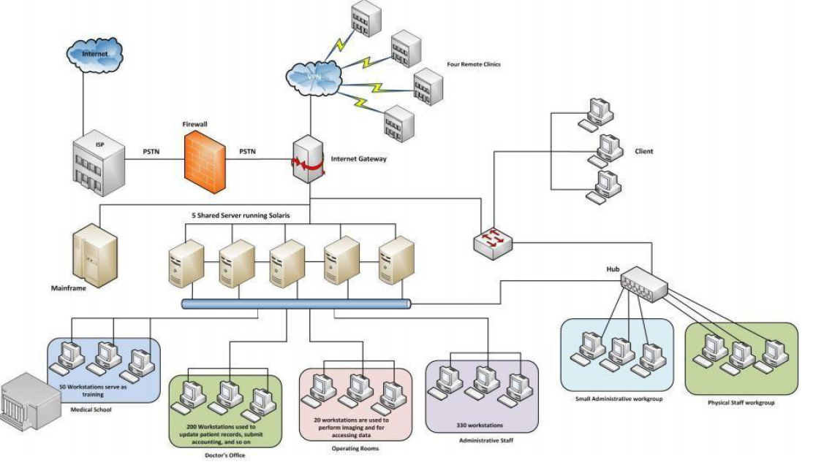
Proposed Network Design

Slide 11
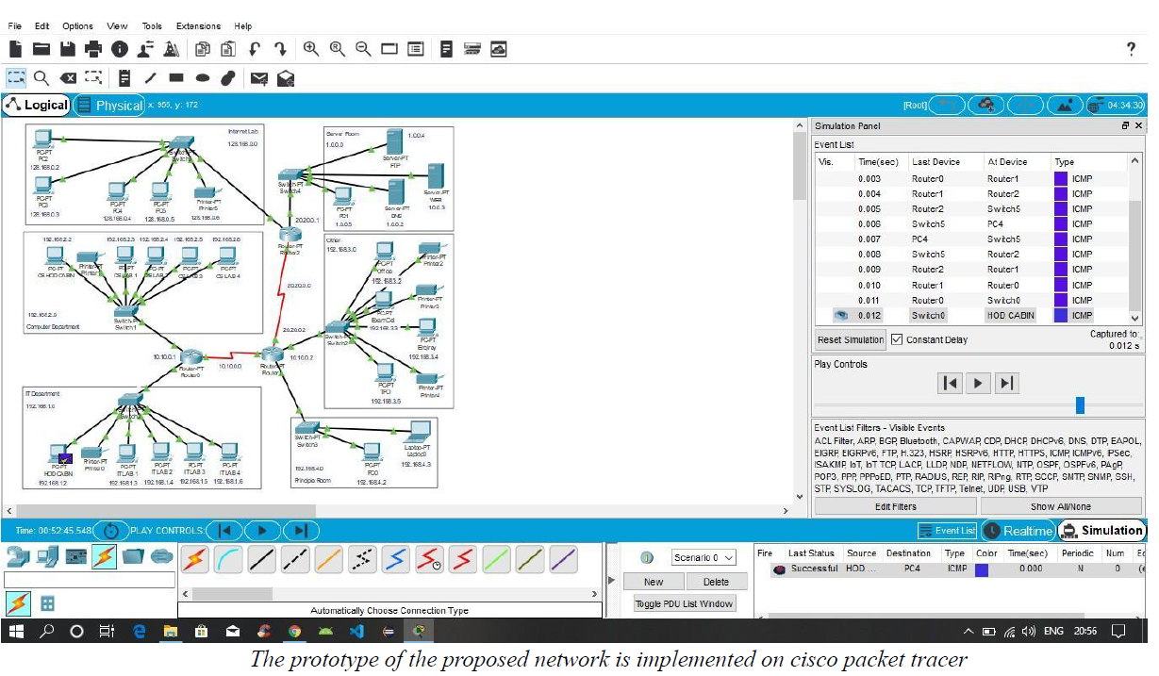

Slide 12
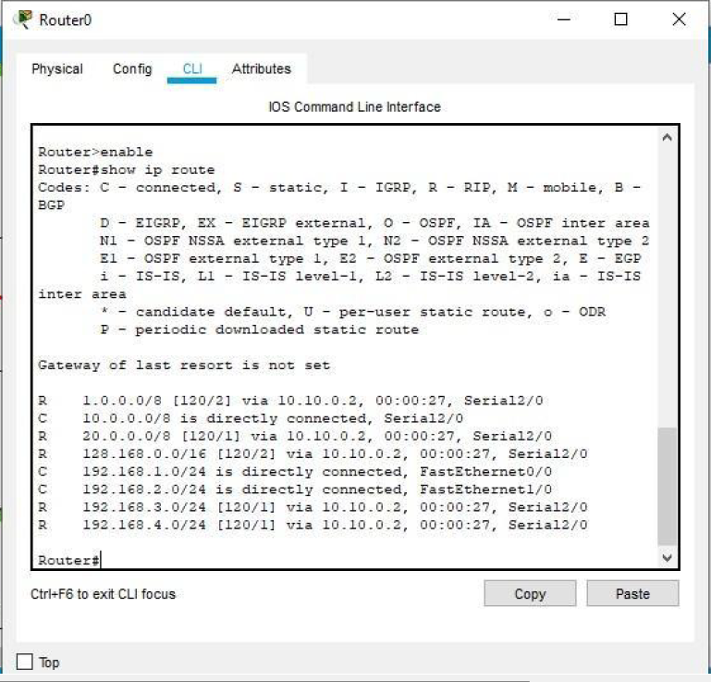
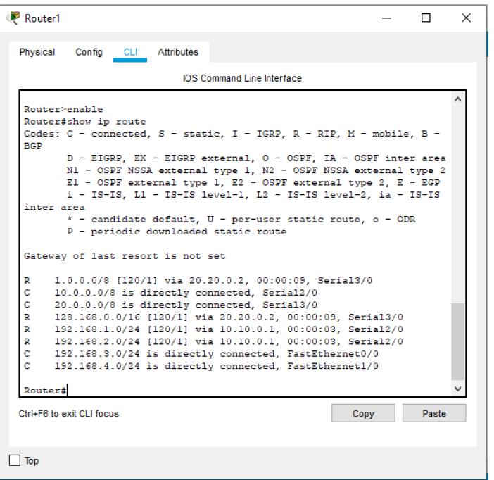
Routing Table for Router 0 and 1

Slide 13
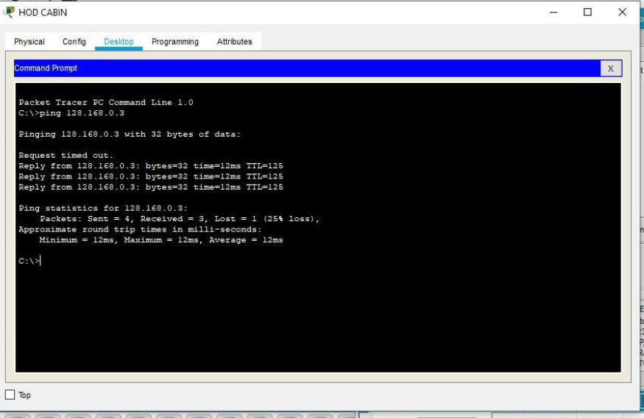
RUNNING TEST

Slide 14
References
1) Sun, L., Wu, J., Zhang, Y., & Yin, H. (2013, April). “Comparison between physical devices and
simulator software for Cisco network technology teaching”. In Computer Science &Education
(ICCSE), 2013 8th International Conference on (pp. 1357-1360). IEEE
2) Roberto Minerva AbiyBiru, "Towards a Definition of the Internet of Things” IEEE IOT Initiative
white paper.
3) “Design and Simulation of Local Area Network Using Cisco Packet Tracer”. The International
Journal of Engineering and Science (IJES) || Volume || 6 || Issue || 10 || Pages || PP 63- 77 || 2017 ||
ISSN (e): 2319 – 1813 ISSN (p): 2319 – 1805.
4) Qin, X. U. E. "Simulation Experimaental Teaching of Computer Networks Based on Packet Tracer
[J]." Research and Exploration in Laboratory 2 (2010): 57-59.
5) Current, John R., Charles S. ReVelle, and Jared L. Cohon. "The hierarchical network design
problem." European Journal of Operational Research 27.1 (1986): 57-66.

Slide 15
Conclusion
We construct the require network for Campus/University
SHIVANSH SINGH_RA2011003010950

